Slide 1
Chapter 3 The Simulation Process and Random Number Generator
Dr. Faiz Al Shrouf

Slide 2
The simulation modeling process
The essence or purpose of simulation modeling is to help the decision marker solve a problem. The idea for development, and use of a simulation model consists of three phases:

Slide 3
The simulation modeling process
1- Problem definition phase
The decision maker communicates the problem to the analyst who in turn formulates the problem in his or her mind.
2- The model development phase
The analyst defines the system and the objective of the modeling effort.
The elements of the system and their relationship are conceptualized (block diagram modules).

Slide 4
The simulation modeling process
Data are gathered (determine the boundaries and restriction of the system.
The model is built (using computer languages).
The model is validated.
Experiments then are conducted using the model based on an experimental design.
The results of the analysis then are shared with the decision marker to verify that the problem has been modeled correctly and that all data desired by the decision marker is included.
Depending on the decision marker’s reaction to the output, it may be necessary to redefine the problem and to repeat the model development phase.

Slide 5
The simulation modeling process
3- The decision support phase
The results of the simulation are give to the decision marker by making a presentation, preparing a report, using graphical animation and so on.

Slide 6
3- Decision Support Phase
Communication
Problem
1-Problem Definition Phase
Formulated
Problem
Decision maker
Proposed solution
Techniques(Modeling)
2- Model Development Phase
Communication
System and objective
definition
Model formulation
Presentation of model results
Conceptual
Model
redefinition
Model Results
Model representation
Communication
Model
Experimentation validation
Experimental Design
Programming
Experimental
Model
Programmed
Model

Slide 7
Random Variables generation
In this section we discussed how you could select appropriate probability distribution to represent random input for model. To do this you must know how to generate random numbers (i.e. common random numbers that draw from a uniform distribution between 0 and 1) and need to transfer them somehow into draws from the input probability distributions you want for your model.

Slide 8
Random Numbers Generation and Testing
For simulation the random numbers generator must have the following desire properties:
It should produce numbers that are random.
It should be fast.
It should not require much computer storage.
It should have a long period before cycling. The object is to select a generation method that produces all of the random numbers that are needed before the cycling occurs.
It should not regenerate; that is not repeating the same number over and over.
It should generate stream of random numbers that can be reproduce. That is for debugging and testing the response of the simulation program for the same stream of random numbers.

Slide 9
Mid-Square Method
The following flowchart represents the steps of generation RN using this method

Slide 10
Start
Select a seed (initial and sample of RN) number X with n-digits. X₁X₂…..X_{n.}
Square X to obtain number Y with m-digits. Y₁Y₂…..Y_{m}= (X₁X₂…..X_{n})²
Add zeros to the left of Y to form Z number with 2n-digits Z₁Z₂…….Z_{2n}=00..0Y₁Y₂…..Y_{m}
Use R as seed
Extract the middle n-digits of Z, which represent by number R, R₁R₂…..R_{n}=Z_{n/2}Z_{(n/2)+1}…….Z_{3n/2}
R represents
a RN
Yes
more RN
End

Slide 11
Example:
Generate first five random numbers using mid-square for seeds,
a- X=13 , b-X=15, c- X=1934 and X=1920?
Answer:
a-
X=13, Y=(13)²=169, Z=0169 then R=16. R=16/100=.16
X=16, Y=(16)² =256, Z=0256 then R=25. R2=25/100=.25
X=25, Y=(25)² =625, Z=0625 then R=62. R3=62/100=.62
X=62, Y=(62)² =3844, Z= 3844 then R=84. R4=84/100=.84
X=84, Y=(84)² =7056, Z=7056 then R=05. R5=05/100=.05
X=05, Y=(05)² =25, Z=0025 then R=02.R6=02/100=.02
X=02, y =(02)² =4, 0004 then R=00 R7=0

Slide 12
Example:
b-
X=15, Y=(15)²=225, Z=0225, then R₁=22
X=22, Y=(22)²=484, Z=0484, then R₂=48
X=48, Y=(48)²=2304, Z=2304, then R₃=30
X=30, Y=(30)²=900, Z=0900, then R₄=90
X=90, Y=(90)²=8100, Z=8100, then R₅=10

Slide 13
Example:
c-
X=1934, Y=(1934)²=3740356, Z= 03740356 then R=7403.
X=7403, Y=(7403)² =54804409, Z= 54804409 then R=8044.
X= 8044,Y=(8044)² =64705936, Z= 64705936 then R=7059.
X=7059, Y=(7059)² =49829481, Z= 49829481 then R=8294.
X=8294, Y=(8294)² =68790436, Z= 68790436 then R=7904.

Slide 14
Example:
d-
X=1920, Y=(1290)²=3686400, Z=03686400, then R₁=6864
X=6864, Y=(6864)²=47114496, Z=47114496, then R₂=1144
X=1144, Y=(1144)²=1308736, Z= 01308736, then R₃=3087
X=3087, Y=(3087)²=9529569, Z=09529569, then R₄=5295
X=5295, Y=(5295)²=28037025, Z=28037025, then R₄=0370

Slide 15
Excel Command
Rand()
RandBetween(0;100)
Text(cell,”0000”)
Mid(cell,2,2)

Slide 16
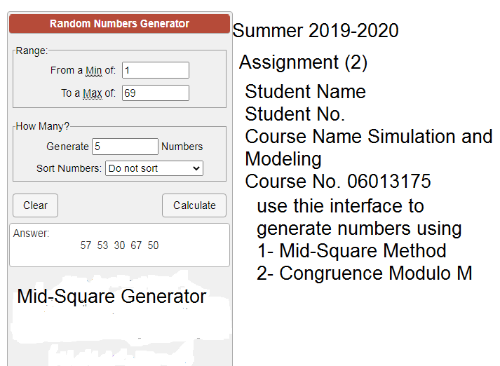
Assignment 2

